Slide 1
Welcome to
SNAPA Teaches Tuesday

Slide 2
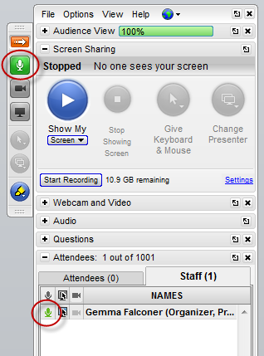
Go to Webinar
Control Panel
Type your questions into the “Question” box at any time during the webinar.
Questions will be addressed as time allows.

Slide 3
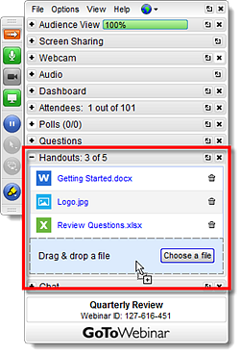
Go to Webinar
Control Panel
Handouts are found using the
Go to Webinar
Control Panel

Slide 4
Webinar and Handouts

Slide 5
Introduction
Carol Gilbert
President of Carol H. Gilbert Consulting
Notes:
Christi Beazley is a food service consultant and trainer for Carol H. Gilbert Consulting working with customers in the K-12 segment. Christi has been in management positions for grocery stores, the sales and customer service manager for Kegel’s Produce and a dining services manager for Willow Valley Retirement Communities. Christi is a SNA and SNAPA member and the secretary for the South Central Area School Food Service Directors group. Christi is board president for Aaron’s Acres, a community benefit organization serving children and young adults with special needs. Christi serves on the occupational advisory board for the Lebanon County Career and Technology Center, past President and Woman of the Year with the Lancaster Area Express Network of the American Business Women’s Association and a member of 100 Women Who Care, Lancaster Chapter.

Slide 6
PRODUCTION RECORD
Tips and Requirements

Slide 7
Focus Points
Identify regulations for production records
Define roles of food service staff
Provide tips

Slide 8
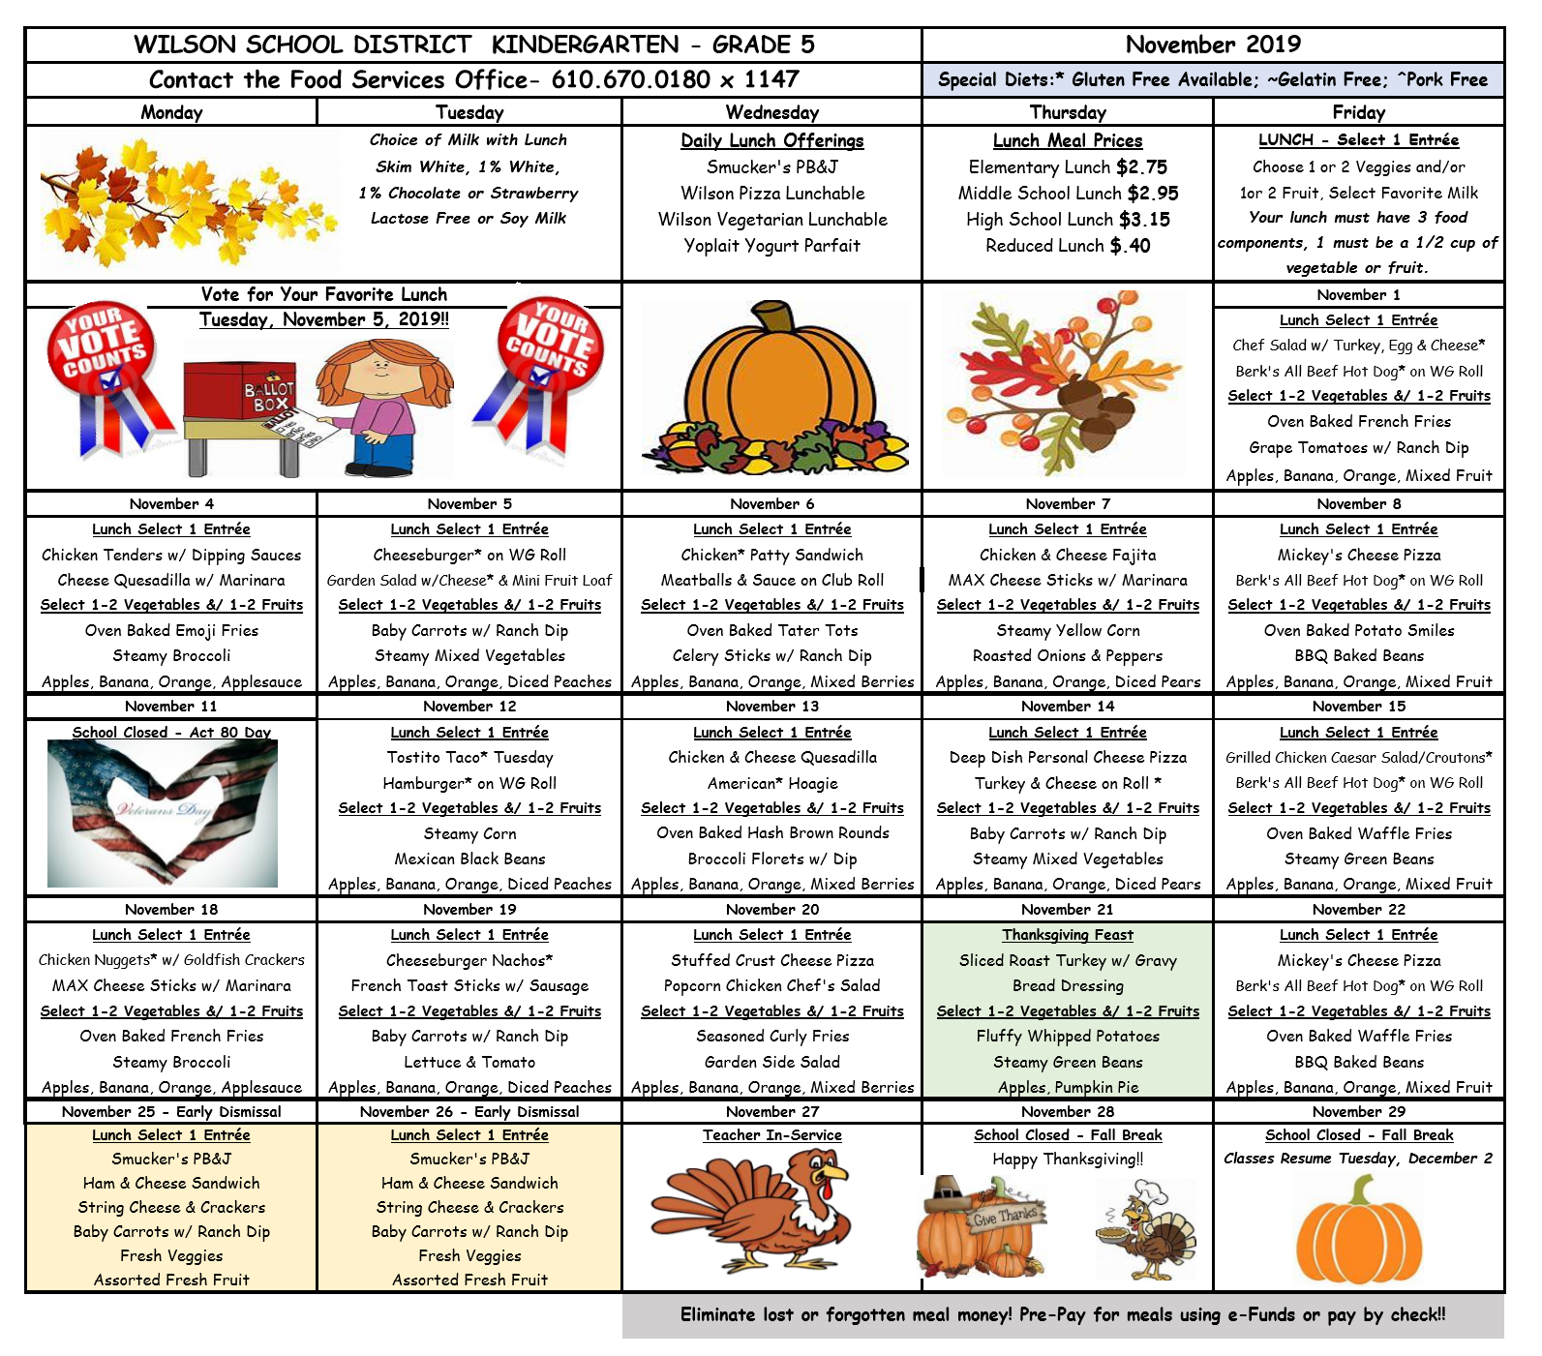
Menu
Basis for production record
Include ALL choices and offerings
Date meal served
Note any menu item changes
Age/grade group

Slide 9
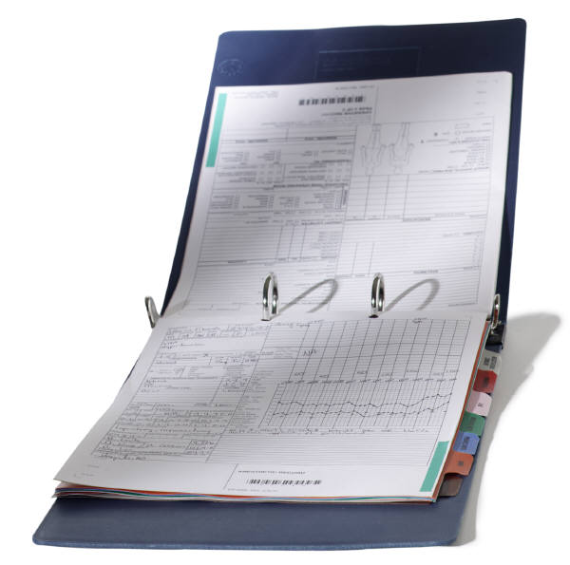
Why Production Records?
Required!
Forecasting – Trends
Ordering tool – Reference
Permanent record- Daily History

Slide 10
Why Production Records?
Ensures enough food is planned for service
Ensures all meal components are offered
Defines items used

Slide 11
Who is Responsible?
Food Service Director
Oversees site production
Completes records
Maintains accurate records
Cafeteria Manager
Oversees site production
Reviews final daily record
Cooks/Production Staff
Follow standardized recipes
Correctly record ingredients being used
Line Servers & Dish Room Staff
Correctly portions food
Communicate student feedback
Record usage
Identify student waste
Ensures correct portioning
Record daily usage

Slide 12
It Takes a Team
Complete your segment
Accurate and detailed
Your input is important

Slide 13
Regulations
Administrative Review
1-week of production records from test month
Actual completed production record from day of review

Slide 14
Regulations
Both breakfast and lunch
Nutrition analysis
Grade level
Fat, calories, sodium

Slide 15
Regulations
Components defined on record
Grade level defined
List what is planned
Record what has been served

Slide 16
Documentation
Menu
Standardized recipes
Nutrition fact sheets
Product formulation statements
Production records

Slide 17
Completing
Menu Item
Recipe/Manufacturer #
Specifics about vegetables and fruit
Frozen, canned
Juice, water, light syrup

Slide 18
Completing
Essential
Planned portion size
Planned reimbursable servings
Total planned servings
Component contribution
Check Food Buying Guide

Slide 19
Food Buying Guide
Electronic
Can download app for smart phone
Resource for
Portioning
Production
Vegetable subgroups

Slide 20
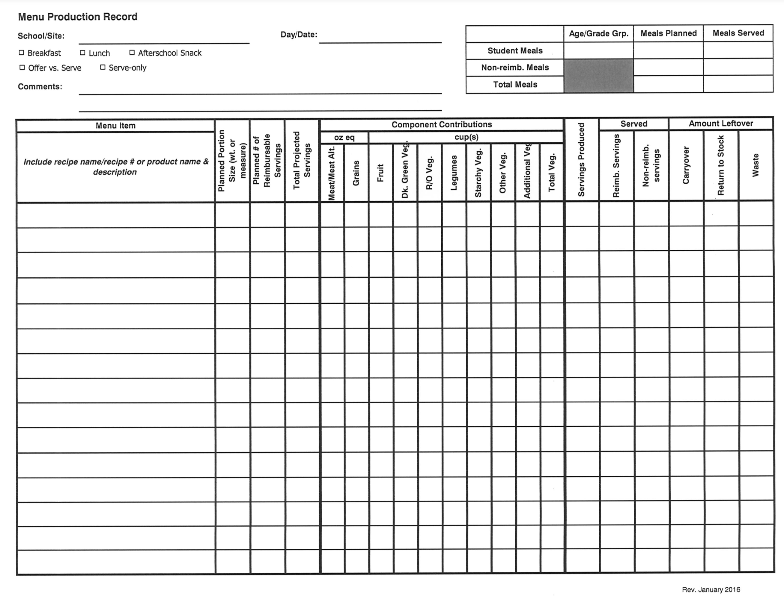

Slide 21
Completing
Essential
Servings produced
Reimbursable served
Non-Reimbursable served
Notes:
Ser

Slide 22
Completing
Essential
Leftovers
Carryover
Return to stock
Waste
Notes:
Ser

Slide 23
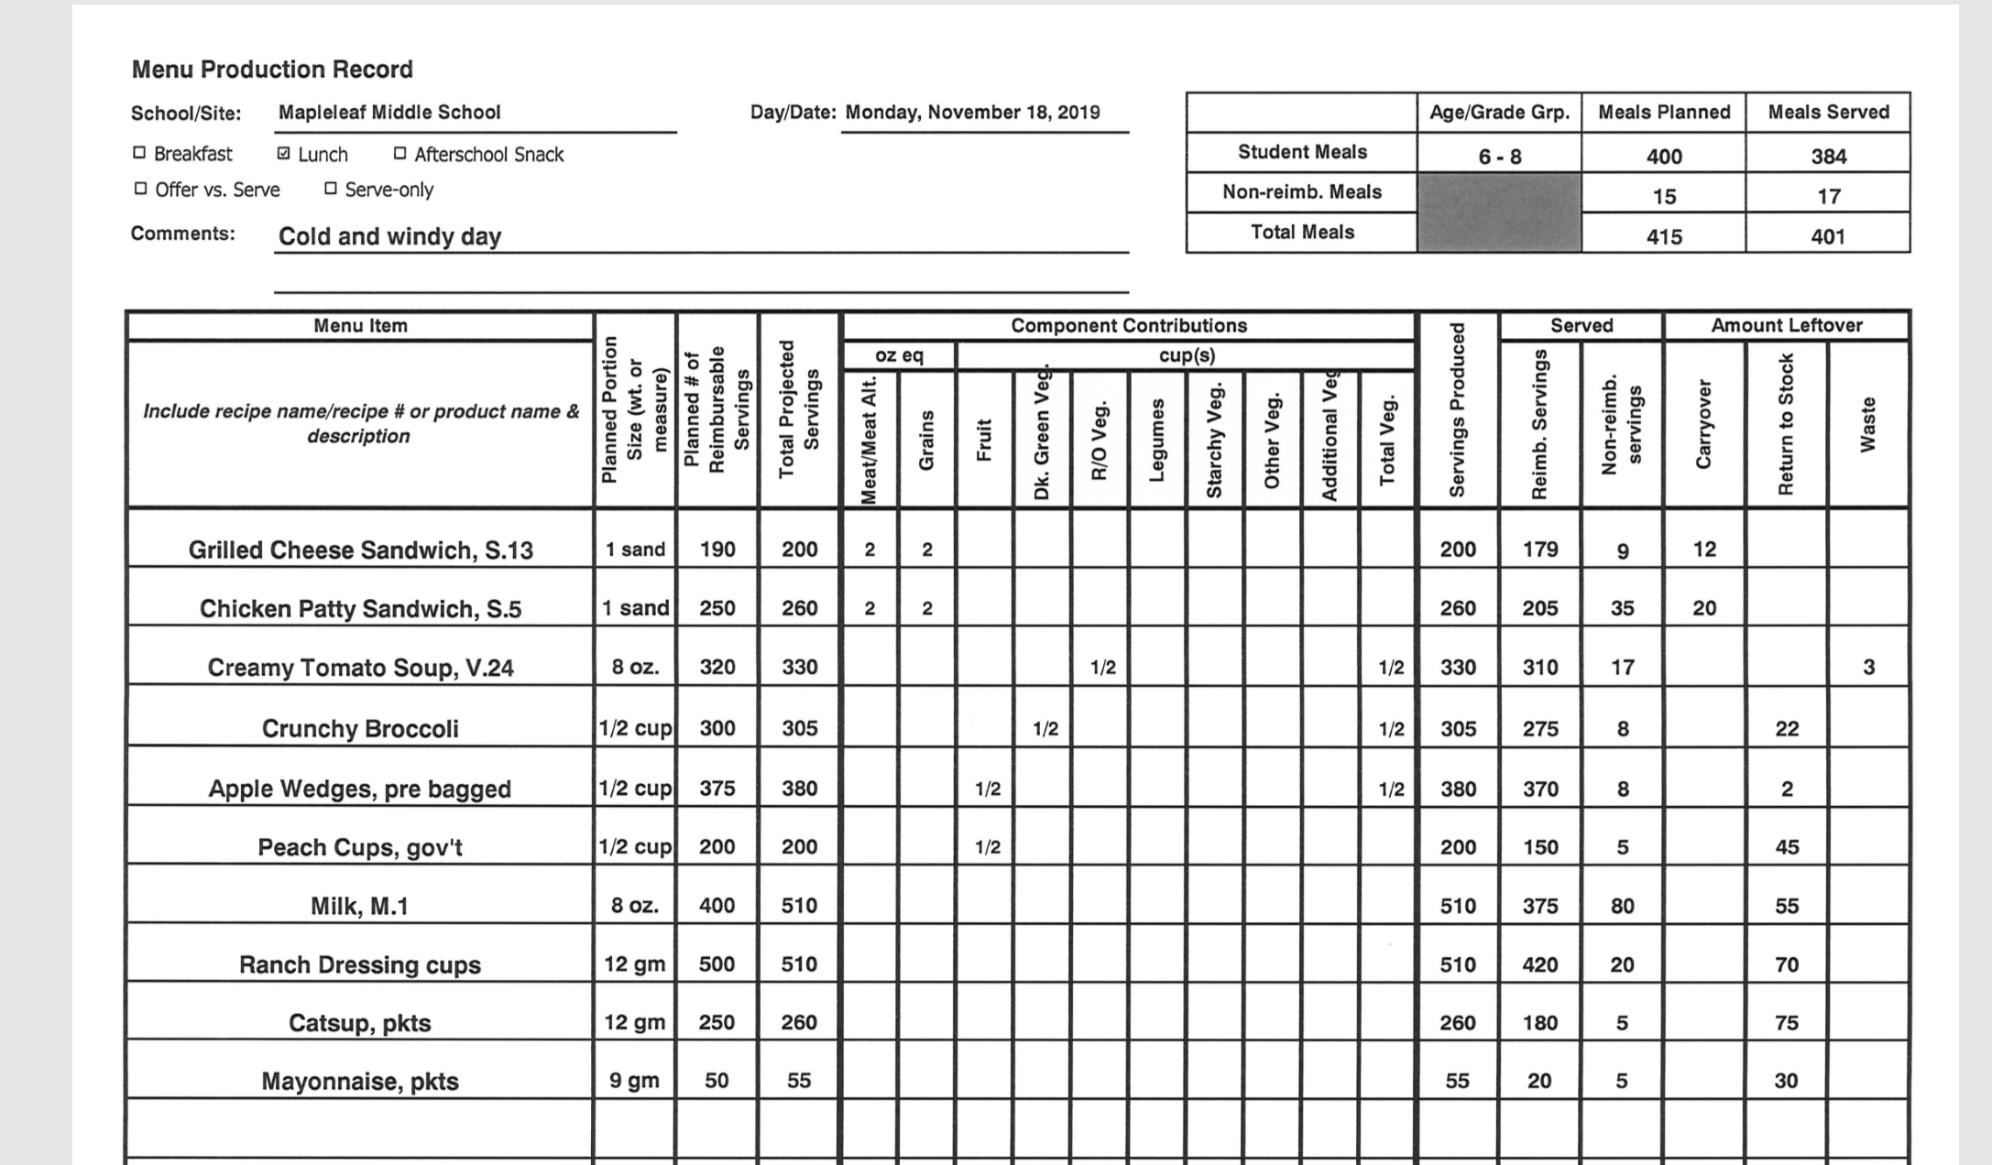
Notes:
Ser

Slide 24
Tips for Completion
Every column has a purpose
Complete all columns for the menu item
If you enter a food fill in the entire line
Complete the record THAT day!!

Slide 25
Tips for Completion
Milk
Types offered
Student planned
Total planned
NOT an inventory tool!
Condiments
Must be listed
Create a recipe

Slide 26
Tips for Completion
Start at the top of the form
Comments are a useful historical record
Keep with a copy of the monthly menu
Record must match the printed menu

Slide 27
Organization
File by month
Include monthly menu
Follow the recipe!
Products used must match information
production record
recipe

Slide 28
Summary
Completion = Teamwork!
Administrative Review requirement
Define pack for fruits and vegetables
Use Food Buying Guide
Be sure to include condiments
Milk is planned, not the inventory
Remember: “To the Best of Your Knowledge!”

