Slide 1
Ideas to Offer Other Tasty Brands Items Besides Grab & Go / Thaw and Serve
Don Hemby – Tasty Brands

Slide 2
Individually Wrapped Products
The amount of Individually Wrapped product schools are purchasing has pushed the vendor community past production capability.
With many, if not most, states potentially closing school for the remainder of the school year, supply issues on IW items will only continue and most likely increase leading to continued massive shortages on IW items.

Slide 3
Schools will need to look for other alternatives or face the possibility of not having meals to serve the many needy children.

Slide 4
Tasty Brands has a number of easy to prepare items that we believe we should offer schools as an alternative to IW items.

Slide 5
These Items Include:
Lasagna Rollups
Mini Cheese Raviolis
Stuffed Shells
Twisted Mozzarella Filled Breadsticks
Mini Tacos
Pizzabolis - Bulk and IW
Mini Pizza Bagels
Jumbo Pizza Bagels

Slide 6
Single Serve Instructions
We are developing a packet for the schools showing them how to prepare the products to get them ready to send home in single serve containers to prepare at home.

Slide 7
Example of Single Serve Instructions

Slide 8
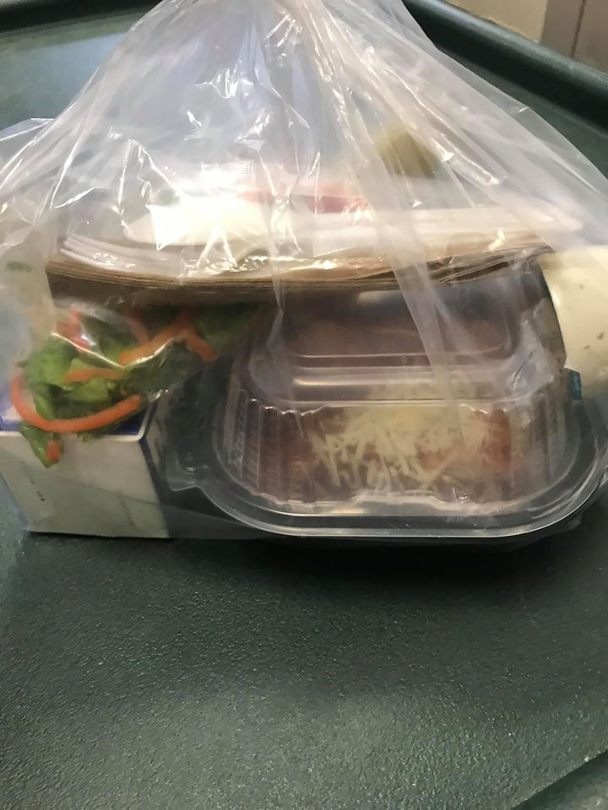
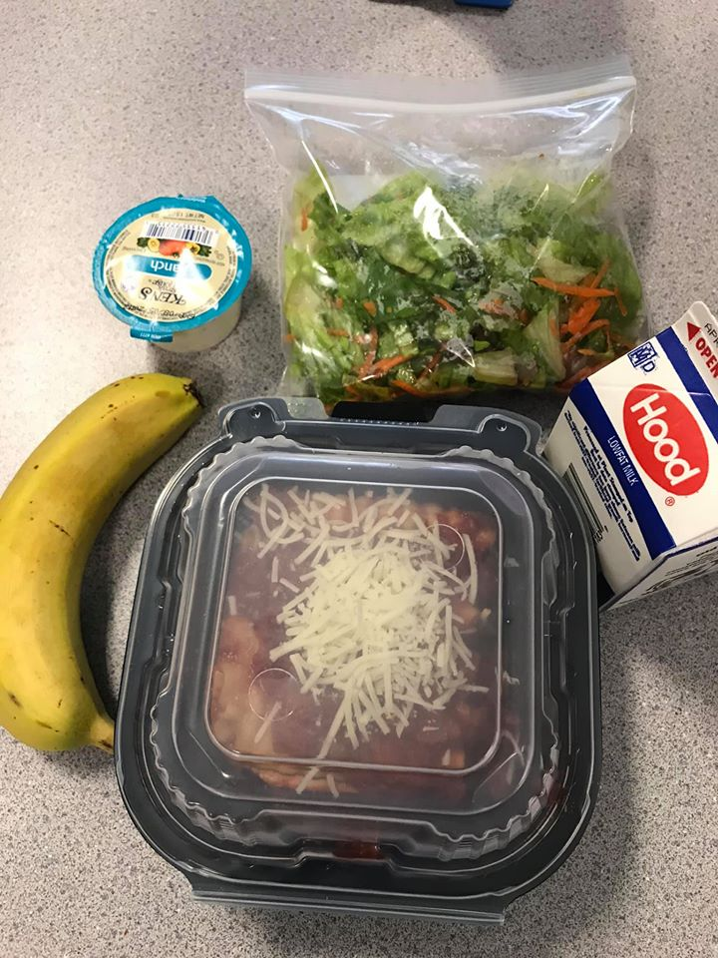
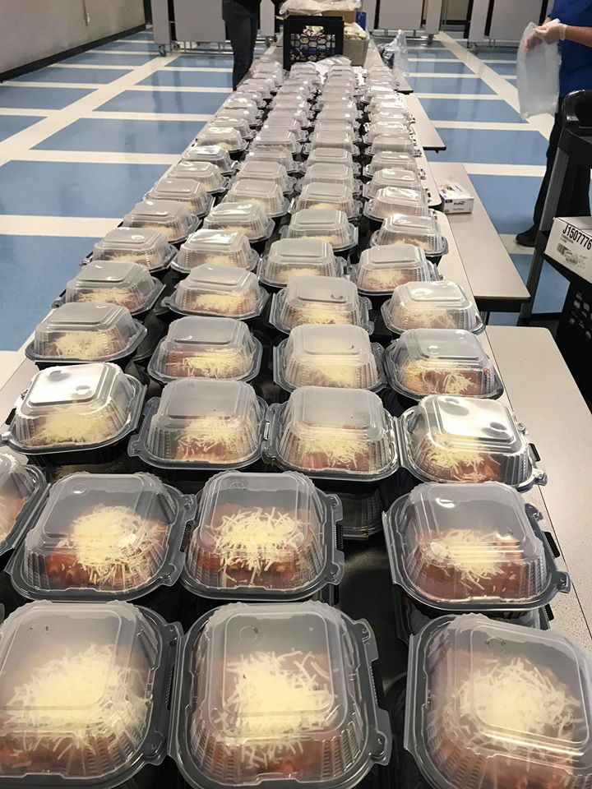
Schools are already doing this!
A school in Vermont recently posted these photos of our frozen lasagna on social media.

Slide 9
Cooking Instructions
We are also developing cooking instructions the schools can give the parents and children on how to easily prepare the products at home in a microwave or home oven.

Slide 10
Example of Cooking Instructions

Slide 11
Important Note
These instructions will all say to prepare from frozen state only.
This will eliminate any issues we might have with holding in the refrigerator too long.

Slide 12
Packaging
Tasty Brands has a good deal of the Turquoise colored heat and eat packaging from our After School Meals roll out.
We would like to use this packaging as an incentive to customers to consider putting these items on their upcoming take home menus.
We will consider giving some cases to schools who might purchase a certain number of cases. We are open to hearing from the field on this.

Slide 13
Conclusion
Our easy to serve frozen items are abundant and ready to ship immediately. These could give the schools some variety in what they offer.
We will be sending each of you an e-mail packet soon of the preparation instructions for the schools and heating instructions for the families.
This will give us all a unique opportunity to reach out to our school customers to see if we can be of service to them during this challenging time.

Slide 14
Important Final Note
While we are talking to them about these items this also gives us one last chance to ask them about their Summer Feeding Pre-booking.
Stay Safe out there. Let us know what we can do to assist.

